Slide 1
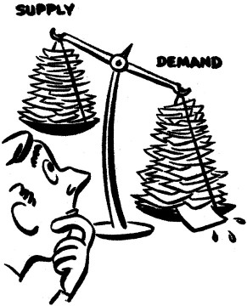
Microeconomics and profit model

Slide 2
Objective
Microeconomic overview
Producers’ Considerations
Example: Design iPad Mini
Example using excel: Design Beam
(BeamProfitMaximizationExample.xls)

Slide 3
What Is Microeconomics?
Demand
Supply
Understand
Maximize
Profit
Decisions
Produce right amount
Consumers
Producers
(We)
Set right price
Producer
Advertising
…

Slide 4
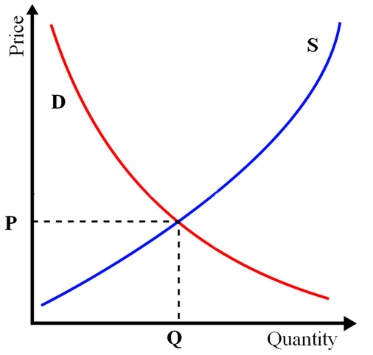
What Is Microeconomics?
Supply
(Producers)
Market
Equilibrium
Demand
(Consumers)

Slide 5
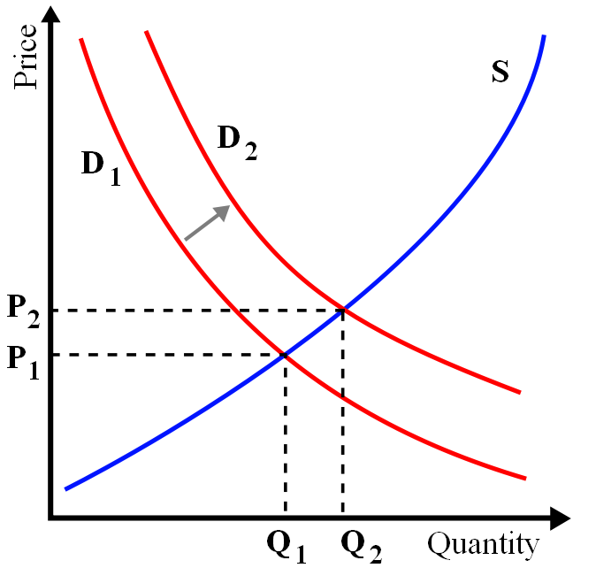
Why Might Curves Shift?
Supply
(Producers)
Demand
(Consumers)

Slide 6
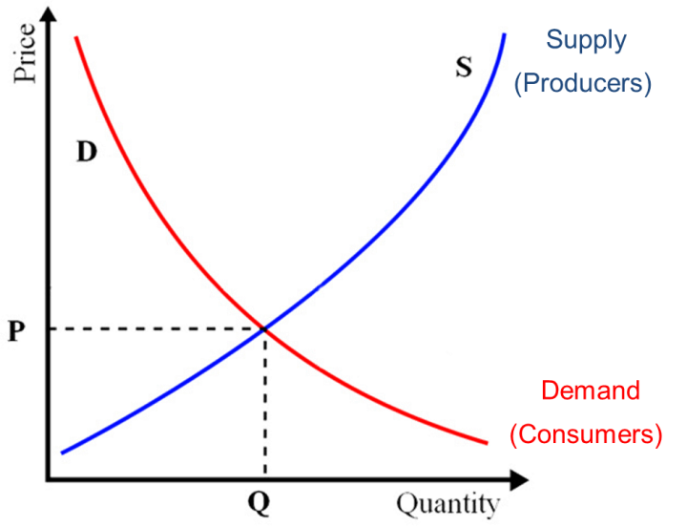
Why might curves shift?
Supply shifts:
Technology improvements
Resource availability decreases
Organizational/Managerial improvements
Competitors entering market
Government intervention
Worker strikes
Demand shifts:
Improved design
Increased income
Perceived status of product increases
Behavioral change
Substitutes get more expensive
Complements get more expensive
Supply shifts:
Technology improvements (shifts right)
Resource availability decreases (shifts left)
Organizational/Managerial improvements (shift right)
Competitors entering market (shift right)
Government intervention (either way)
Worker strikes (shift left)
Demand shifts:
Improved design (shift right)
Increased income (shift right)
Perceived status of product increases (shift right)
Behavioral change (either way)
Substitutes get more expensive (shift right)
Complements get more expensive (shift left)

Slide 7

Producers’ Considerations

Slide 8
Producers’ Considerations
Costs (labor, materials, distribution, and manufacturing)
Pricing
Production quantities
Investment in new technologies
Manufacturing process
Available storage
Time of distribution chain
Attractiveness of product
Product features
Seasonal demand
Manufacturing → brokers → distributors → retailers → consumer

Slide 9
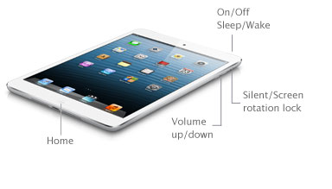
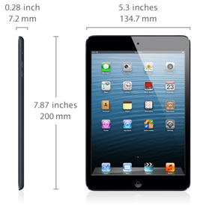
Example: IPad MINI
Engineering Decisions
Storage capacity (32GB, 64GB, 128GB, etc)
Battery life
Shape/dimensions
Screen size
Functionality
Pricing/Production
Price ($329, $429, $529, etc)
Volume
Prices of applications
Warranty availability
Investment Decisions
Viable for release in 2017
Release new gens in 2018, 2019, and 2020

Slide 10

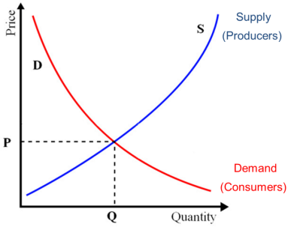
Linear Demand Model
Price, p ($)
λ_{p} is price sensitivity (and dictates slope)
quantity demanded = $x$-intercept – (price sensitivity) x (price)
q = θ – λ_{p} p
Not valid near intercepts!
|
θ
Quantity, q

Slide 11




Estimating Demand Sensitivity
Assuming linearity and independence, use data to estimate values:
Price, p ($)
λ_{p} = - Δq/Δp
Δq
Δp
|
θ
Quantity, q
*Model works best with small changes in attributes and price

Slide 12
Where Does Data Come From?
Find information on competitors or similar products
Survey customers on what they are willing to pay (WTP) for products

Slide 13
Price Sensitivity
Price, p ($)
q = θ – λ_{p} p
λ_{p} is price sensitivity
p₁ = $329
p₂ = $304
q₁ = 10
q₂ = 13
|
θ
Quantity, q
(million units)
Price sensitivity:

Slide 14
Profit, π
Price, p ($)
q = θ – λ_{p} p
λ_{p} is price sensitivity
p₁ = $329
q₁ = 10
|
θ
Revenue = pq = area = $3.29 billion
Quantity, q
(million units)
Revenue = price ^{x} quantity
R = pq = p(θ – λ_{p} p)
π = R – c
profit
revenue
cost
π = p(θ – λ_{p} p) – c

Slide 15
Optimal Revenue
R = pq = p(θ – λ_{p} p)
*To optimize, we set derivatives equal to zero.
5.21
Revenue, R (B$)
Price, p ($)
R = p(θ – λ_{p} p)
$208.33
|
50M
25M
Quantity, q

Slide 16

Design Sensitivity
When Apple adds storage space to the iPad mini, how does demand change?
16 GB
32 GB
Demand increases by x million units
if you increase storage by 1 GB…

Slide 17
Where Does Come From?
λ_{d}
λ_{d} = design sensitivity
e.g., for some unit attribute change, what is the increase in quantity demanded?
Find information on competitors or similar products
Survey customers on what they are willing to pay (WTP) for products

Slide 18
Design Sensitivity
Price, p ($)
λ_{d} is design sensitivity
(i.e., the magnitude of this shift)
p₂ = $379
p₁ = $329
D₂ (32 GB)
R₁ = $3.29 billion
D₁ (16 GB)
R₂ = $4.55 billion
q₁ = 10
q₂ = 12
|
θ
Quantity, q
(million units)
With n attributes α, λ_{d} is a vector of n design sensitivities
Quantity = Intercept – (price increase effects)+(design improvement effects)
q = θ – λ_{p} p + λ_{d}^{T} Δα
π = p(θ – λ_{p} p + λ_{d}^{T} Δα) – c

Slide 19

Design Sensitivity
Storage (GB)
Battery Life (hours)
Looking at consumer trends, we conclude:
Each additional GB adds 1.3 M units to demand
Each additional hour of battery life adds 0.7 M units to demand
λ_{d} = [1.3/GB, 0.7/hr.]

Slide 20
Optimal Revenue
λ_{d} = [1.3/GB, 0.7/hr.]
q_{new} = θ – λ_{p} p+ λ_{d}^{T} Δα
q_{new} = 50 – 0.12p + (1.3/GB)*16GB + (0.7/hr.)*6 hr.
q_{new} = 50– 0.12p + 20.8 + 4.2 = 75 – 0.12p
11.72B
Price, p ($)
Revenue, R (B$)
5.21B
$312.50
$208.33
D₁(16GB, 10 hr.)
D₂(32GB, 16 hr.)
|
50M
|
75M
Quantity, q
25M
37.5M

Slide 21
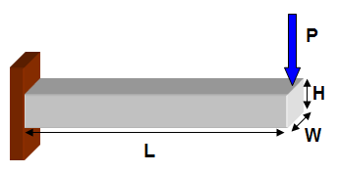
Example using Excel
(BeamProfitMaximizationExample.xls)
Simple Microeconomic Model
Consider
Price sensitive λ_{p}
Refine Microeconomic Model
Consider
Price sensitive λ_{p}
Design sensitive λ_{d}

Slide 22

What Questions do you have?

